Slide 1
MapBox GL JS By: Divyansh Chaudhary

Slide 2
Agenda
Key Mapbox Components
Mapbox GL JS overview
Key Mapbox Features
Installation for Mapbox GL JS
Customizing Maps
Adding Markers to Map
Adding Interactivity

Slide 3

Key Mapbox Components
1.) Mapbox GL JS: A JavaScript library for interactive, customizable maps that render vector tiles and support dynamic styling.
2.) Mapbox studio: A web-based tool for designing and customizing maps, allowing users to style layers, add data, and create map templates.
3.) Mapbox Navigation sdk: Tools for adding turn-by-turn navigation to mobile applications, supporting both iOS and Android platforms.
4.) Mapbox events and API’s for services integration into applications

Slide 4

MapBox GL JS overview
A powerful javascript library for interactive customizable maps.
Enables developers to create fast and visually stunning maps using vectors tiles and WebGL.

Slide 5
Mapbox Key Features
Vector Tiles: Quick Rendering and smooth zooming
Custom Styles: easily style maps using JSON and Mapbox Studio
Interactivity: Supports popups,tooltips and various event handlers
Performance: Optimized for high performance across devices

Slide 6
Why use Mapbox ?
1.) Features: Vector Maps, Mapbox studio
2.) Performance : Large Datasets
3.) Flexibility: Customizable with a learning curve
4.) Pricing: Freemium Model

Slide 7
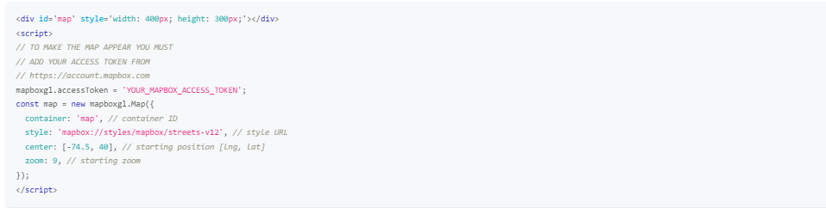
Installation
Include Mapbox GL JS via CDN or mapbox-gl npm package
1.) Include the Javascript and CSS files in the head of the html file. And sign up for a mapbox account to get the access token.

Slide 8
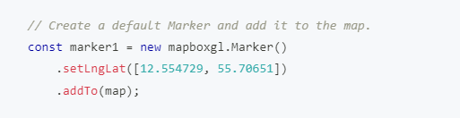
Adding Markers to the Map
We can add markers using Marker class in mapbox GL JS.
The marker class is used to place marker at a geographical location. It also allows to customize the appearance and attach popups to it
Syntax:

Slide 9
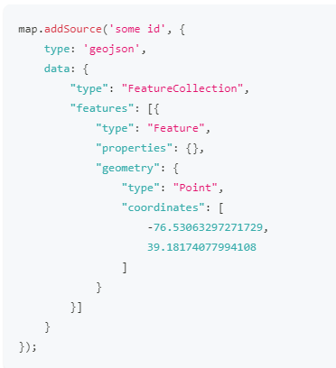
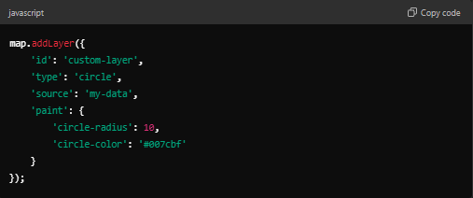
Customizing Maps with Sources & Layers
Add GeoJSON source, images and other layers
Syntax:

Slide 10
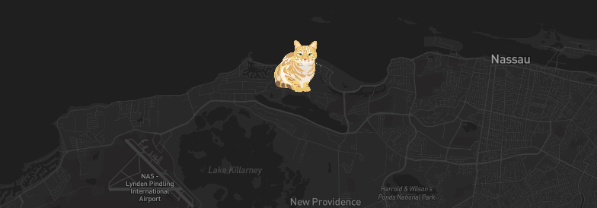
Adding An Icon to the Map
Upon loading, the map uses loadImage then addImage followed by addsource to add a data source containing one point feature and addlayer to create a new symbol layer that uses the icon to represent the point data.

Slide 11
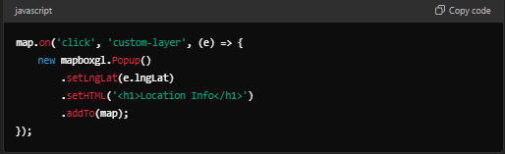
Adding Interactivity
Display information on clicks and hovers with Popups and Tooltips.
Example:

Slide 12
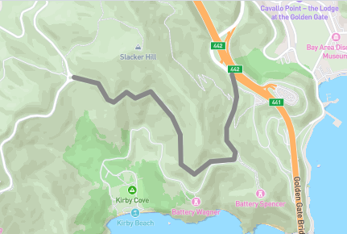
Add a Line using a GeoJson Source
Add a GeoJSON line to a map using addsource then style it using addlayer’s paint properties.

Slide 13
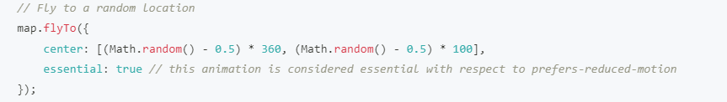

FlyTo & FitBounds in Mapbox
FlyTo: Use flyTo to smoothly interpolate between locations.
FitBounds: fitBounds() pans and zooms the map viewport so that the new visible area includes the user’s specified location. Takes southwest & northeast corners of the area as input.

Slide 14
Use Cases and Comparison
Mapbox: Best for applications requiring advanced mapping features. Used in web-applications & mobile-apps for responsive apps
React-leaflet: Ideal for simpler applications or basic mapping functionalities with rapid development.

Slide 15
References
Documentation Link:
https://docs.mapbox.com/mapbox-gl-js/guides

Slide 16
Thank You !! Have a great day ahead

